Slide 1
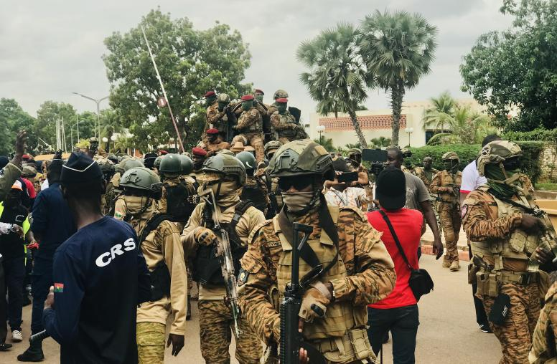
COUP WATch: Analytics for the global stage
Chris Smith
Yale University
Jackson School of Global Affairs

Slide 2
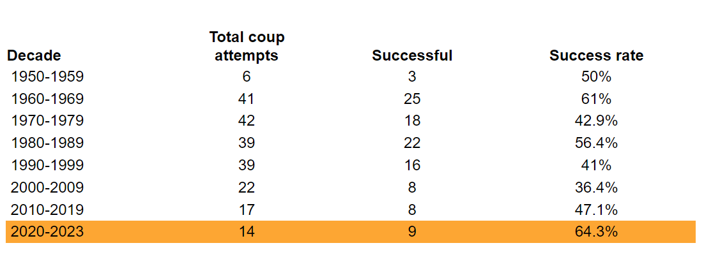
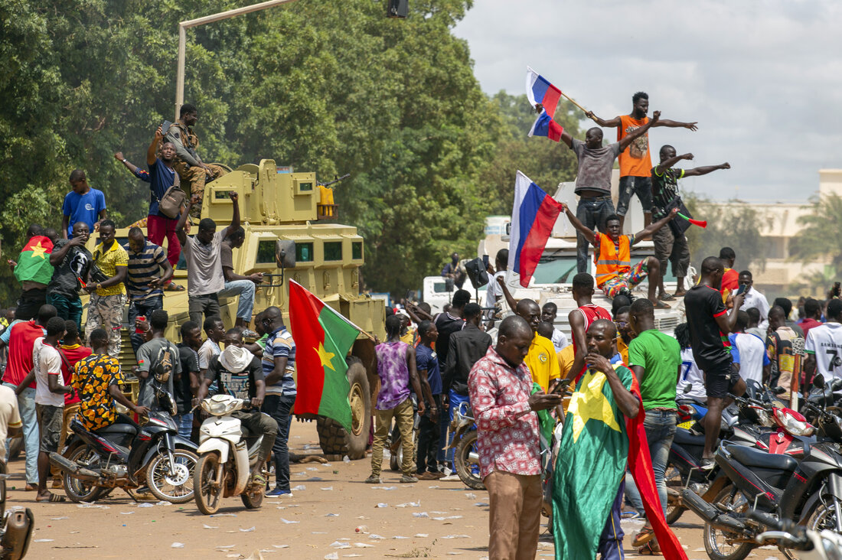
Project focus
Since 1960, there have been 220 coup d’etat attempts in African Nations. Of those, 109 have been successful. The prevalence of coups has increased since 2020 with 14 attempts in the last 4 years.
This is concerning and highly significant for the US government as it competes for influence across Africa with Russia and China.
I would like to see how we can we leverage open source data to create a picture of coup risk in the Sahel Region of Africa?
How can AI help?

Slide 3
Methodology
Use data regarding economic outlook, political expression, stability, coup history, and open source media reporting to assess coup risk in 13 Sahel countries.
Weight specific data indexes and present an overall comparison between the countries indicating which is the most likely to experience a coup within the next 12 months.

Slide 4
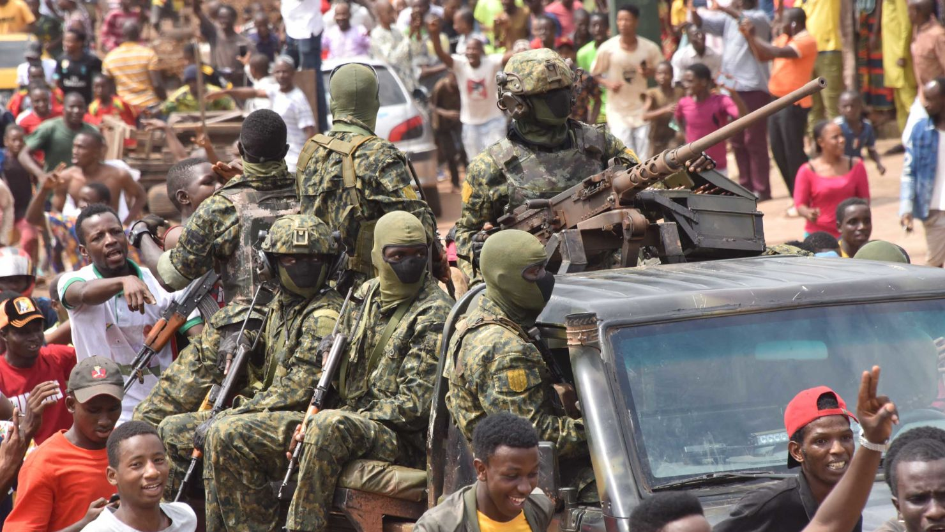
COUNTRIES and Data SOURCES
Countries of Interest:
Mali
Niger
Chad
Burkina Faso
Mauritania
Cameroon
Benin
Togo
Ghana
Cote d'Ivoire
Sudan
Guinea
Nigeria
Data Sources:
ACLED Conflict Index Score
Fragile State Index Score
IMF World Economic Output predicted Per Capita GDP for 2025
Coup History Since 1960
Fredom House Freedom Score
Coup related keywords Open Source Media Reporting

Slide 5
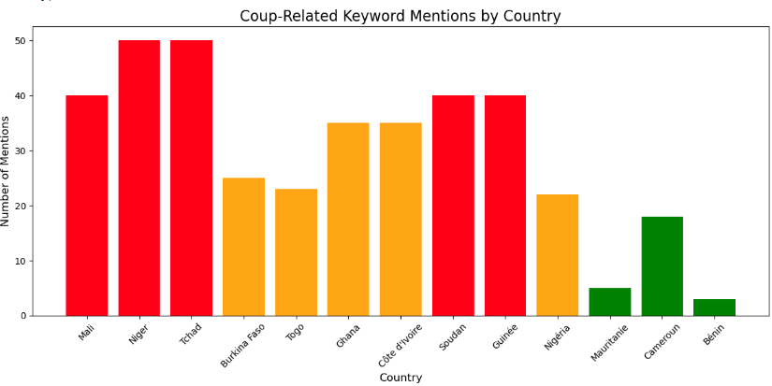
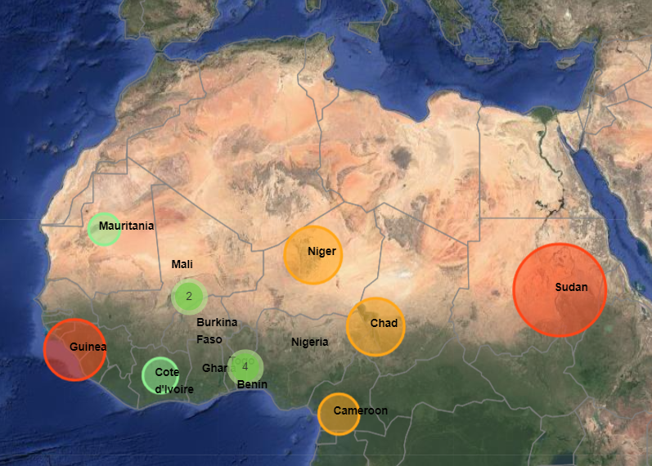
Product
I will create an analysis tool that assesses the likelihood of a coup relative to other countries based on the data sets
I will overlay the data with a media scrub of key words related to coups and political instability
Final product will be a comprehensive assessment of the region highlighting the countries at the highest risk for a coup

Slide 6
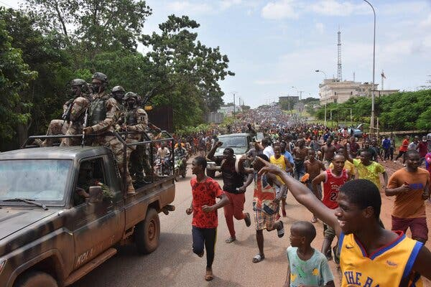
questions

Slide 7

Chris Smith
Yale University
Jackson School of Global Affairs

